Slide 1
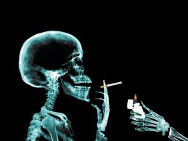
SMOKING AND IT’S EFFECTS!
BY,
Ashwin.Hariharan And Group

Slide 2
What is smoking?
Smoking is a practice in which a substance, most commonly tobacco or cannabis, is burned and the smoke is tasted or inhaled.
This is primarily practiced as a route of administration for through the recreational drug use, as combustion releases the active substances in drugs such as nicotine and makes them available for absorption e lungs.
The most common method of smoking today is through cigarettes, primarily industrially manufactured but also hand-rolled from loose tobacco and rolling paper. Other smoking implements include pipes, cigars, bidis, hookahs, vaporizers and bongs.
It has been suggested that smoking-related disease kills one half of all long term smokers but these diseases may also be contracted by non-smokers. A 2007 report states that about 4.9 million people worldwide each year die as a result of smoking.

Slide 3
CAUSES OF SMOKING
Despite the prevalence of smoking, the factors that lead a person to start smoking are difficult to understand. In many cases, smoking is started at a young age due to peer pressure, tobacco advertising, or a concept that smoking is an acceptable behavior. Many people who start smoking have a family member or close friend who smokes.
Once started, cigarette smoking and chewing tobacco are difficult to stop. It is a well-known fact that smoking and chewing tobacco are behaviors that can become addictions due to the presence of nicotine and other chemicals generated from smoking. Like many other addictive substances, these chemicals trigger a series of biochemical reactions and pleasant sensations to which you can quickly become accustomed. Regular tobacco users eventually develop a need to experience these sensations in order to feel normal, which makes quitting a difficult challenge.

Slide 4
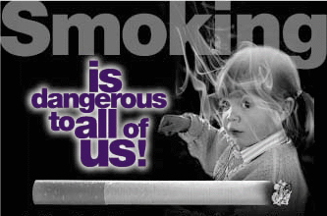
How is smoking Dangerous?
Smoking can damage our body as it affects our lungs, brains and heart.
It causes many deadly diseases such as heart diseases, lung diseases, diabetes, blindness, it even causes cancerous diseases!!!
Tobacco contains the chemical nicotine which can easily get us addicted to smoking.
The more you smoke, the more you want to continue to smoke. Your body becomes physically dependent on the drug and begins to crave it.

Slide 5
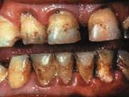
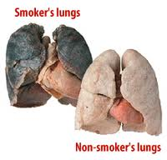
Is smoking cool?
Peer pressure is when someone is telling you what to do but you don't want to because you think it's bad. Sometimes, people think that it is popular or cool to smoke. Sometimes peers try to get you to smoke with them.
But is it really cool or popular to smoke? Here is what happens to people who smoke a lot.
I don’t think this is cool, do you?

Slide 7
An Interview with Smoker
Simyan: So Smoker can you tell me the reason behind your name?
Smoker: I smoke a lot so people started calling me Smoker.
Simyan: Does this bother you? And how did you get into smoking?
Smoker : Well it does bother me because it keeps reminding me how miserable my life has become. I started smoking 7 years back when I was 19 years old. My friends told me that I can become cool and popular by smoking and so I started smoking and now I am addicted to it.
Simyan: So has your life become miserable because of smoking and how?
Smoker: Yes smoking is the reason. My health has deteriorated because of smoking, I have developed gum problems, my teeth has lost its shine and has turned yellow in colour, my breath stinks and worst of all people ten to stay away from me.

Slide 8
Simyan: So don’t you think its about time you quit smoking?
Smoker: Yes but how I am addicted to smoking.
Simyan: Did you know that smoking kills 4.9 million people every year worldwide as it causes deadly diseases such as throat cancer lungs cancer?
Smoker: Well I was aware of its causes but 4.9 million people die every year! Now I so want to get rid of smoking. Please help me.
Simyan: Sure thing, the first thing you need to do is take a strong initiative of quitting smoking, next you should throw away your cigarette supply and try not to buy anymore of them with the thought it will help you save money, join anti smoking groups and ask your family members and friends to help you.
Smoker: Yes you are right these are some useful tips. I will put all my heart in getting rid of the addiction.

Slide 9
HOW SMOKING AFFECTS THE SOCIEY??
Studies have shown that men are more likely to smoke than women. Twenty four percent of men in the US smoke, approximately 26 million men. Women make up eighteen percent of smoking adults, 21 million women.
If current tobacco use patterns persist, an estimated 6.4 million children will die prematurely from a smoking-related disease.
Each day, nearly 6,000 children under 18 years of age start smoking; of these, nearly 2,000 will become regular smokers. That is almost 800,000 annually.
The poor are more likely to smoke than the wealthy.
People of developing countries are more likely to smoke than those of developed countries.
The total economic costs (direct medical costs and lost productivity) associated with cigarette smoking are estimated at $10.47 per pack of cigarettes sold in the United States.

Slide 10
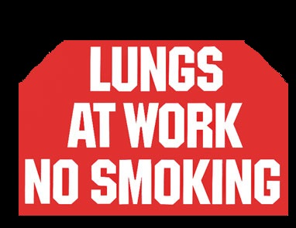

Slide 11
CAN YOU HELP SOMEONE STOP??
You can definitely help them quit smoking by:
Supporting them and motivating them in this cause. Tell them about its harmful effects, about the deadly diseases it CAUSES.
Highlight the consequences of smoking by showing what happens to ones teeth and lungs through illustrations.
Tell them to throw there cigarette supply and not to buy any more cigarettes and show them how they can financially benefit by not buying cigarettes anymore.

Slide 12
WAYS TO STOP SMOKING
If you want to get involved with an anti-smoking campaign in your area, have your parents contact one of the following organizations.
If you know someone who wants to quit smoking, tell them about our web site :
www.whydoyousmoke.weebly.com
Promise that you'll never smoke by signing a pledge stating that you will be tobacco-free. Get family members and people in your community to join you.
Look for tobacco advertising in your community and if you see it somewhere, write them a letter asking them to stop advertising.
Contact local businesses and restaurants in your area that allow smoking and ask them to make their establishments smoke-free.
Design your own anti-smoking t-shirt.
Paint posters to encourage kids not to smoke. With your teacher's permission, hang them in classrooms, the school library and the cafeteria.
Volunteer to speak to other students .
Start an anti-smoking club with other kids at school.

Slide 13
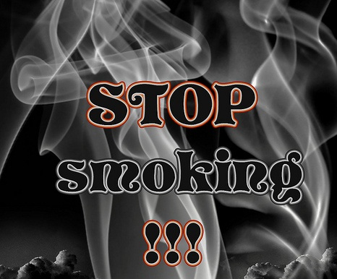
SOLUTION
Quitting Smoking can Save Your Life The health effects of smoking are serious, dead serious! the good news is that once you quit smoking your body begins to repair itself. Stop wasting your life, time, and money on this deadly addiction. Quit smoking NOW!

